Slide 2
1 Motivation & System Overview
Localize a distant object by looking at it through a smartphone.
Queries based on a distant object, rather user’s current location, can be entirely natural.
OPS could potentially be used to improve GPS, particularly where the GPS errors are large or erratic.
Improve cars’ safety. Smartphones mounted near the car’s windshield could estimate location of other objects in the surroundings, and trigger appropriate reactions, such as adaptive cruise control, lane change detection, blind spot alerts, etc.
Proposed an Object Positioning System (OPS) that achieves reasonable localization accuracy.
Uses computer vision to create an approximate 3D structure of the object and camera.
By solving (nonlinear) optimizations on the residual (scaling and rotation) error, ultimately estimate the object’s GPS position.

Slide 3
2 The 3D Structure – Structure from Motion
Utilize SfM as a “black box” utility.
SfM accepts multiple photos from the user, and on each photo, runs an algorithm known as a feature detector to identifies various “interesting” points of the photo, called keypoint.
The keypoints are matched across all the pictures.
As output OPS receives a 3D point could of estimated <X,Y,Z> coordinates for each keypoint that was successfully matched across a sufficient number of images, also an estimated <X,Y,Z> camera pose coordinates from where each photo was originally taken.
The 3D structure is not in absolute scale, needs to be “grounded” on the physical coordinate system.

Slide 4
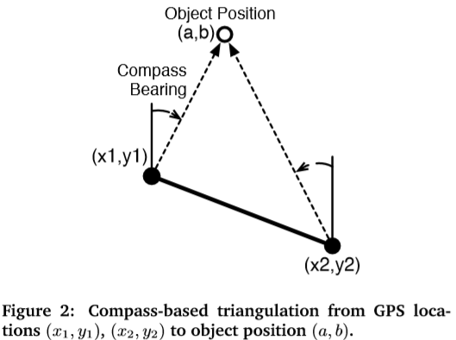
3.1 Problems of triangulation via GPS/compass
In principle, if a user points her phone at an object-of-interest from two distinct locations, it should be able to easily infer the object’s location.
We can’t ask the user to walk too far.
Compass precision becomes crucial, and smartphone sensors are not nearly designed to support such a level of precision.

Slide 5
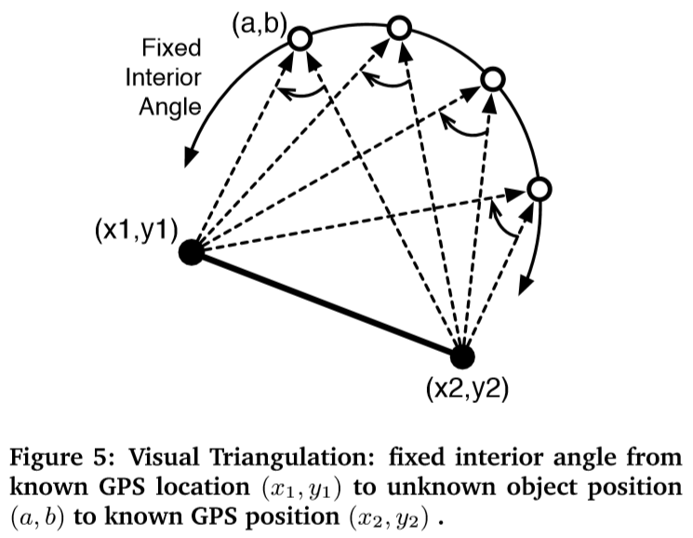
3.1 Problems of triangulation via camera
Multiple views of an object from different angles, even if only slightly different, produce visual distortions, due to the phenomenon of parallax.
It would be possible to infer the interior angle between a pair of GPS locations and the object position from multiple images.
However, knowing the interior angle is again not adequate to pinpoint the object location.
Instead it offers a curve and the object can be at any location on this curve.

Slide 6
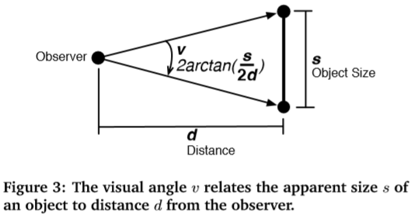
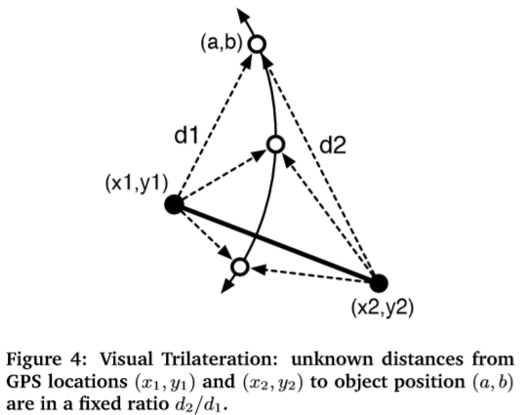
3.1 Problems of trilateration via camera
Trilateration requires estimating the distance to the object-of-interest, from two vantage points.
We only know visual angles, but don’t know object size, so we can’t compute d.
However, knowing two different visual angles from two distinct locations, it’s possible to obtain a ratio of the distances to the object from these locations.

Slide 7
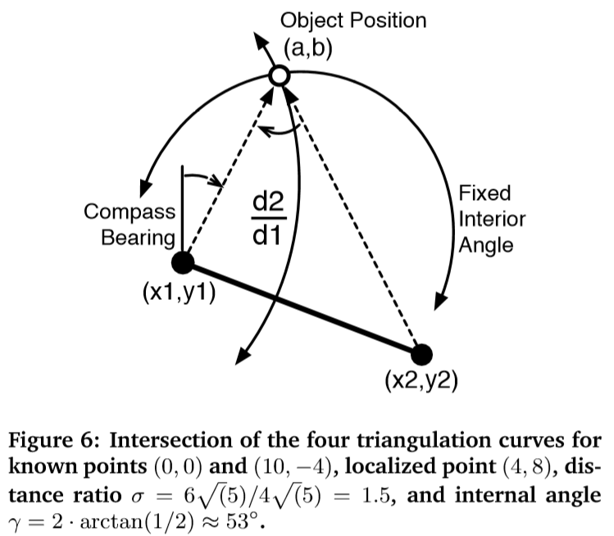
3.1 Combining Triangulation and Trilateration
Computing the intersection of the two curves (in Fig.4 and Fig.5) yields a small number of intersection points.
With compass triangulation added, this is an over-constrained system, meaning that there is more than sufficient information to compute an unique solution. And this excess of information will later form the basis for noise correction on imperfect sensors.
To find a single point of convergence, we will rely on optimization techniques, finding the most-likely true object point by minimizing estimates of sensor error.

Slide 8
3.2 The Converged Design of OPS
Two important points the influenced the final design of OPS
Any optimization would need to be constrained to be limited in the number of degrees-of-freedom and avoid degenerate cases.
We would need a mechanism to reduce the impact of GPS error.
We don’t consider latitude and longitude directly, as angular values are inconvenient for measuring distances. Instead, we apply a precise Mercator projection to the square UTM coordinate system and refer to a latitude/longitude position as a simple 2D (x, y) coordinate.

Slide 9
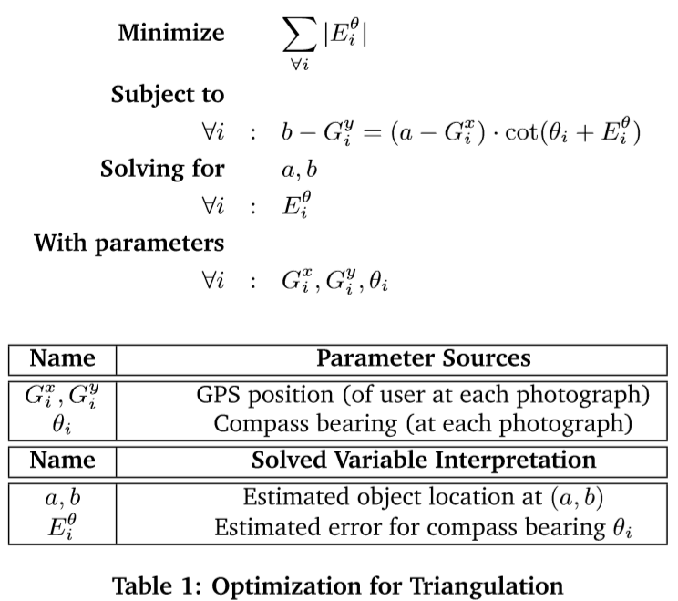
3.2.1 Sensor-only optimization for triangulation
Due to sensor error, we can expect that all pairs $C_{n}^{2}$ of compass lines will result in $C_{n}^{2}$ different intersection points.
The optimization seeks to find the most-likely single point of intersection by rotating each compass bearing as little as possible until all converge at the same fixed point $\left(a,b\right)$.

Slide 10
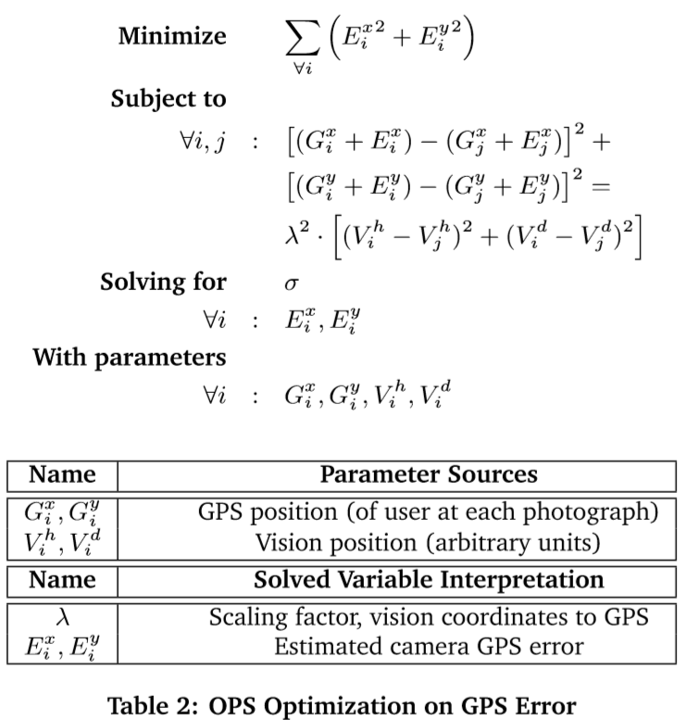
3.2.2 GPS-correction optimization
Rely on the output of SfM to correct for random GPS noise. Bias across all GPS measurements will remain.
A nonlinear programing optimization that seeks to move the GPS points as little as possible, such they match the corresponding relative structure from vision, to obtain a set of fixed GPS points:

Slide 11
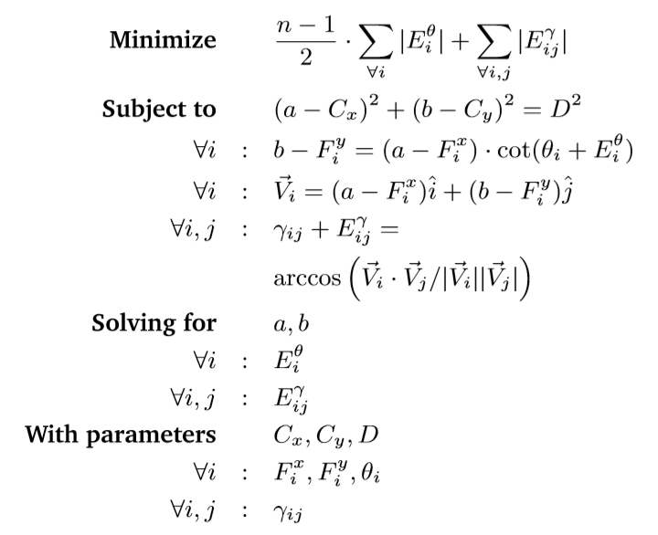
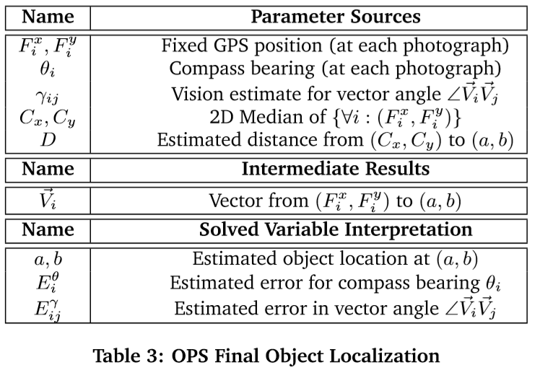
3.2.3 OPS optimization on object location
$γ_{ij}$ directly encodes our original interpretation of visual triangulation.
Visual trilateration is fully incorporated as hard constraints.

Slide 12
4 Implementation
OPS is implemented in two parts, an OPS smartphone client and a back-end server application.
Computer Vision (server-side)
For structure from motion (SfM), we use Bundler, an open-source project written by Noah Snavely, operating on an unordered set of images to incrementally-build a 3D reconstruction of camera pose and scene geometry.
Nonlinear Optimization (server-side)
Mathematica is used through a Python API for solving nonlinear optimizations.

Slide 13
5 Evaluation
Problems
Phone sensors are subject to noise and biases.
GPS can be impacted by weather (due to atmospheric delay), clock errors, errors in estimated satellite ephemeris, multipath, and internal noise sources from receiver hardware.
Compass magnetometers are affected by variations in the Earth’s magnetic field and nearby ferromagnetic material.
Computer vision techniques, such as SfM, can break down in a variety of scenarios. For example, keypoint extraction may fail if photographs have insufficient overlap, are blurred, are under or over-exposed, or are taken with too dark or bright conditions.

Slide 14
5.1 Accuracy of Object Localization
Settings
We tested OPS at more than 50 locations on or near the Duke University campus, and considered objects at distances between 30m and 150m away.
The object should be far enough away that it makes sense to use the system, despite the hassle of taking photographs.
Distances are limited by the user’s ability to clearly see the object and focus a photograph.
Take 4 photographs for each localization (the minimum required for SfM), each successful photograph was taken between 0.75m and 1.5m from the location of the preceding photograph, in no specified direction.
Once the user takes the required photos, processing requires approximately an additional 30-60 seconds.
SfM is sensitive to the quality of photographs. In poor light, keypoint detection becomes less robust. So, we test OPS in daylight conditions.
Compare OPS accuracy to “Optimization (Opt.) Triangulation.”

Slide 15
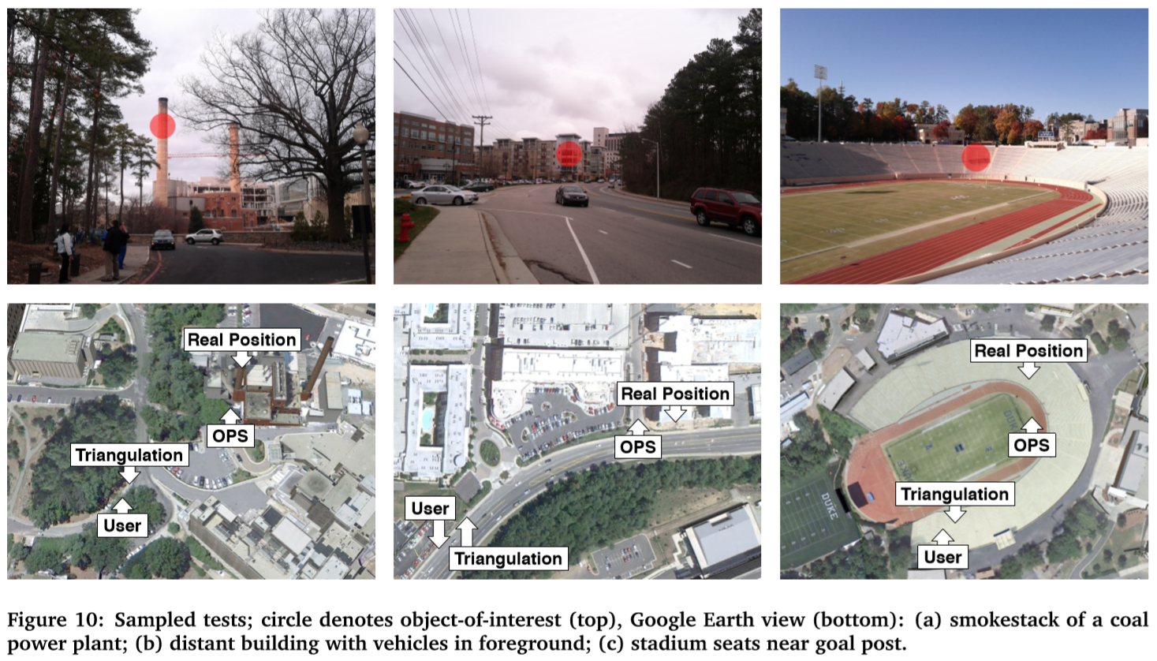
5.1 Accuracy of Object Localization

Slide 16
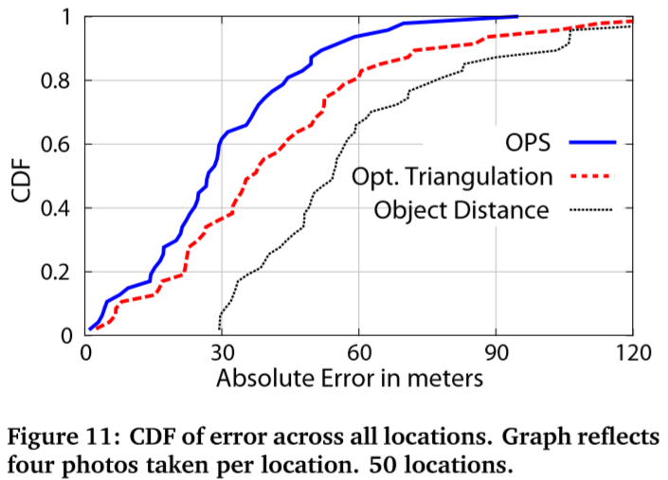
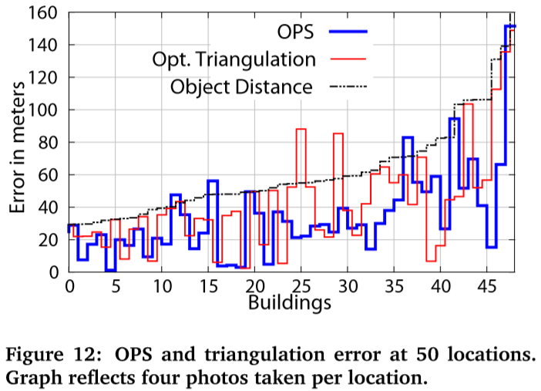
5.2 Overall Performance

Slide 17
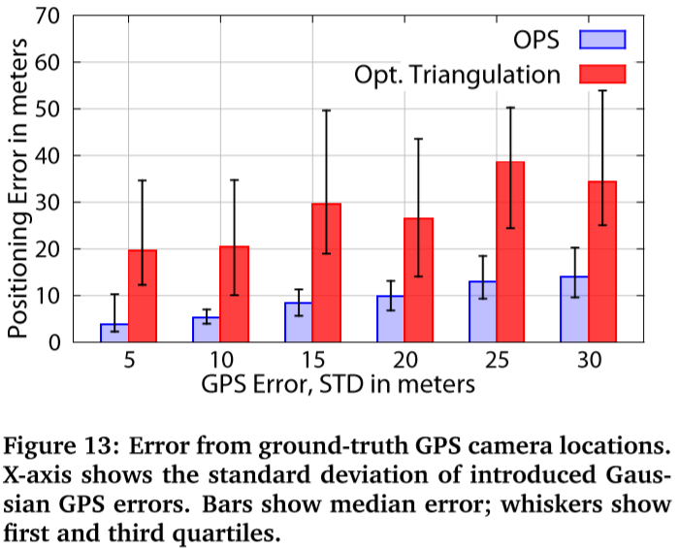
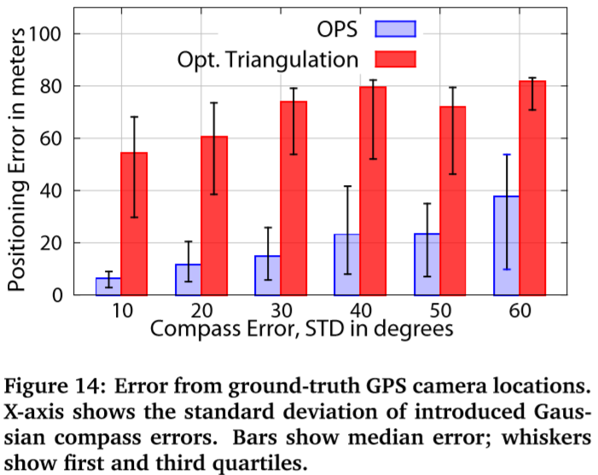
5.3 Sensitivities – To GPS and Compass Error
Took a set of 4 photos from a mean distance of 87m, ensure vision error-free.
Use Google Earth to mark the exact location for each photo, then mathematically computed the compass bearing to the object.
Randomly perturbed each GPS point or compass angle according to random deviates of a Gaussian distribution with mean 0 and a varied std.

Slide 18
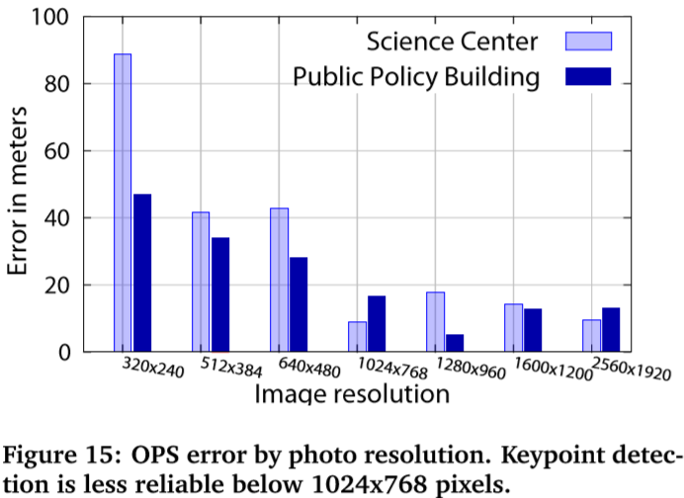
5.3 Sensitivities – To Photograph Detail

Slide 19
6 Room for Improvement
Live Feedback to Improve Photograph Quality.
Imagine a system of continuous feedback to the user, to suggest when a “good” photograph can be taken.
Improving GPS Precision with Dead Reckoning （航位推算）.
Continual Estimation of Relative Positions with Video.

